Slide 1
Large-scale Systems for Web data processing

Slide 2
The size of the Web
How large is the Web?
The Indexed Web contains at least 4.83 billion pages (Wednesday, 26 October, 2016) [1]
Facebook has 1.3B users which form a graph of 400B connections [2]
Twitter has 288M active users and 60B followers [3]
Most of this content is textual of graph data. Both types encode valuable knowledge that Web companies monetize
[1] http://www.worldwidewebsize.com/
[2] A. Ching, S. Edunov, M. Kabiljo, D. Logothetis, and S. Muthukrishnan, “One Trillion Edges: Graph Processing at Facebook-scale,” Proc. VLDB Endow., vol. 8, no. 12, pp. 1804–1815, Aug. 2015.
[3] http://www.beevolve.com/twitter-statistics/

Slide 3
The problem of scale
The problem is not the size. It’s the growth.
http://www.internetlivestats.com/total-number-of-websites/

Slide 4
The problem of scale
The problem is not the size. It’s the growth
http://www.internetlivestats.com/twitter-statistics/

Slide 5
The problem of scale
The problem is not the size. It’s the growth.
Internet Live stats
In the startup world, the problem of scale is called hypergrowth or blitzscaling
Reid Hoffman - Blitzscaling
Stanford course ”How to start a startup”, lecture 6
Handling growth at Facebook

Slide 6
How can we handle scale?
Batch processing systems
Hadoop
Spark
Stream processing systems
Storm
Heron
Graph engines
Giraph
Ajira
Important
Notes

Slide 7
How can we handle scale?
Batch processing systems
Hadoop
Spark
Ajira
Important
Notes

Slide 8

Hadoop
1st assumption Simple primitives go a long way
2nd assumption Computation is too expensive for one machine
3st assumption Data does not fit in one machine
4rd assumption Commodity machines are cheap and fail often

Slide 9
Hadoop
Simple primitives go a long way
In 2004, Dean and Ghemawat wrote a seminal paper describing MapReduce [1]
The idea, used extensively at Google, was to encode a large spectrum of analytical operations using two operations: Map and Reduce
[1] J. Dean and S. Ghemawat, “MapReduce: simplified data processing on large clusters,” Communications of the ACM, vol. 51, no. 1, pp. 107–113, 2008.

Slide 10
Hadoop
Simple primitives go a long way
The main idea behind MapReduce is that analytical jobs execute two operations
They transform the input in some sort of intermediate data (map)
They aggregate the intermediate data and do some additional computation (reduce)

Slide 11
Hadoop
Computation is too expensive for one machine
Map operations are atomic. Parallelism is trivial
Reduce requires initial aggregation. Each group can be processed in parallel
Hadoop takes care of the parallelism and automatically distributes map/reduce on more machines

Slide 12
Hadoop
Computation is too expensive for one machine
Hadoop is an opensource distributed implementation of MapReduce.
Written in Java, it is the most popular
Big-data framework.
Users only need to write the Map/reduce operations.
The distribution and parallelism are automatic.
Picture from http://research.google.com/archive/papers/mapreduce-sigmetrics09-tutorial.pdf

Slide 13
Hadoop
Data does not fit in one machine
HDFS is the most popular distributed filesystem
The same block of data is replicated on multiple nodes.
Distribution is independent to the user. You see a normal filesystem

Slide 14
Hadoop
Commodity machines are cheap and fail often
Hadoop implements highly sophisticated mechanisms for fault-tolerance
Yahoo! had probably the largest Hadoop cluster in production: 42K nodes [1]
Hadoop is the #1 product by market share in the Big Data Analytics category and 1,200+ companies uses it [2]
[1] http://www.hadoopwizard.com/which-big-data-company-has-the-worlds-biggest-hadoop-cluster/
[2] http://wiki.apache.org/hadoop/PoweredBy

Slide 15

Spark
1st assumption Simple primitives go a long way
2nd assumption Computation is too expensive for one machine
3st assumption Data does not fit in one machine
4rd assumption Commodity machines are cheap and fail often

Slide 16
Spark
MapReduce has two main limitations
Lot’s of disk I/O (due to fault tolerance and usage of HDFS)
Inability to perform iterative computation
Many extensions were proposed

Slide 17
Spark
First introduced in 2010 from lab in Berkeley [1]
Goal: generalize MapReduce to support more operations than Map/Reduce
Two additions
Fast data sharing
General DAGs
Core abstraction: RDD (Resilient Distributed Datasets)
[1] M. Zaharia, M. Chowdhury, M. J. Franklin, S. Shenker, and I. Stoica, “Spark: cluster computing with working sets.,” HotCloud, vol. 10, pp. 10–10, 2010.

Slide 18
Spark
Spark programs perform user-defined operations on RDDs
RDDs:
collections of objects spread across a cluster, RAM or Disk
Built in parallel
Rebuilt on failure
Operations:
Transformations (map, filter, groupBy)
Actions (count, collect, save)
Operations are lazy, only performed when needed

Slide 19
Spark
Example: Load error messages from a log into memory, then search for specific patterns [1]
RDD
Transformed RDD
Action
[1] Example taken from: http://www.slideshare.net/rxin/stanford-cs347-guest-lecture-apache-spark?from_action=save

Slide 20
Spark
Programs can be written in Python and Scala
Many more operations than Map/Reduce

Slide 21
Spark
Project available under the Apache Umbrella
More info here

Slide 22
Ajira
1st assumption Simple primitives go a long way
2nd assumption Computation is too expensive for one machine
3st assumption Data does not fit in one machine
4rd assumption Commodity machines are cheap and fail often

Slide 23
Ajira
At Yahoo!, over 80% of Hadoop jobs completed within 10 minutes [1]
At Microsoft, the median input size of Hadoop jobs was under 14GB. Facebook under 100GB [2]
Most of these jobs are unlikely to fail [1]
[1] K. Elmeleegy, “Piranha: Optimizing short jobs in hadoop,” Proceedings of the VLDB Endowment, vol. 6, no. 11, pp. 985–996, 2013.
[2] R. Appuswamy, C. Gkantsidis, D. Narayanan, O. Hodson, and A. Rowstron, “Scale-up vs Scale-out for Hadoop: Time to rethink?,” in Proceedings of the 4th annual Symposium on Cloud Computing, 2013, p. 20.

Slide 24
Ajira
Framework developed at the VU [1] for the computation of MapReduce jobs without overhead
Two main novelties
Higher expressivity than Spark
No overhead => faster execution
[1] J. Urbani, A. Margara, C. Jacobs, S. Voulgaris, and H. Bal, “AJIRA: A Lightweight Distributed Middleware for MapReduce and Stream Processing,” in 2014 IEEE 34th International Conference on Distributed Computing Systems (ICDCS), 2014, pp. 545–554.

Slide 25
Ajira
Main abstraction
In Ajira, computation is a sequence of generic actions
Input => set of tuples. Output => other tuples
Output of one action is the input of the following one
A sequence of actions is called a chain. A program executes multiple instantiations of chains
An instantiation of a chain:
reads the tuples from the input layer
executes the actions in a single thread

Slide 26
Ajira
Main abstraction
Actions can generate new chains. This is called branching
Used to implement iterative computation
Partition the computation into multiple chains
The output of one action can be split in multiple (sub)-chains
Multiple chains can be merged into a single instantiation
These operations can be defined at runtimes

Slide 27
Ajira
Branching is a cornerstone primitive of AJIRA
(To the best of our knowledge) no other system supports its logic

Slide 28
Ajira
Branching is used to parallelize (and distribute the computation)
Its advantage is that the parallelization doesn’t affect the rest of the workflow

Slide 29
Ajira

Slide 30
Ajira
Another important primitive is split.
It allows that the output of on action is being processed by two sub-chains. For example

Slide 31
Ajira
With the special action merge, we can unify the output of multiple chain instantiations into a single one

Slide 32
Ajira
Ajira can be executed both in cluster mode and in local mode
Very little overhead. Ideal for DAS cluster

Slide 33
Ajira
Price of overhead

Slide 34
Ajira
Code: https://github.com/jrbn/ajira
Documentation: http://jrbn.github.io/ajira/
Price of overhead
AJIRA: up to 370 times faster than Hadoop
up to 3 times faster than Spark

Slide 35
Hadoop vs Spark vs Ajira
Important
In Enterprise you often have non-technical constraints that dictate your Big data technology
In the Web, 99% of the actors are startups without no such constraint
Choosing the right technology is hard and requires a lot of work
Lesson learned: Pick the technology that gets the job done quickly and in a neat way

Slide 36
How can we handle scale?
Stream processing systems
Storm
Heron
Important
Notes

Slide 37
Storm
Batch processing
Input is fixed
Computation is changing
Stream processing
Computation is fixed
Input is changing
Stream processing is central on the Web. It has been studied since decades [1], but it is only with the Web that it became very important
[1] G. Cugola and A. Margara, “Processing flows of information: From data stream to complex event processing,” ACM Computing Surveys, 2012.

Slide 38
Storm
Opensourced by Twitter in 2011 [1]. It can process large streams of data in a distributed cluster. Used in production at Twitter
[1] A. Toshniwal et al., “Storm@Twitter,” in Proceedings of the 2014 ACM SIGMOD International Conference on Management of Data, New York, NY, USA, 2014, pp. 147–156.

Slide 39
Storm
Input = unbounded sequence of tuples
Spouts = sources of streams
Spouts can get the streams from various sources (logs, API calls, etc.)
TUPLE
TUPLE
TUPLE
TUPLE
TUPLE

Slide 40
Storm
Bolts are the operational blocks that manipulate streams Inside bolts you can
Apply transformations
Filter
Aggregations
Etc.
TUPLE
TUPLE
TUPLE
TUPLE
TUPLE
TUPLE
TUPLE
TUPLE
TUPLE
TUPLE
TUPLE
TUPLE
TUPLE
TUPLE
TUPLE

Slide 41
Storm
Topologies are directed graphs of spouts and bolts
TUPLE
TUPLE
TUPLE
TUPLE
TUPLE
TUPLE
TUPLE
TUPLE
TUPLE
TUPLE
TUPLE
TUPLE
TUPLE
TUPLE
TUPLE
TUPLE
TUPLE
TUPLE
TUPLE
TUPLE
TUPLE
TUPLE
TUPLE
TUPLE
TUPLE
TUPLE
TUPLE
TUPLE
TUPLE
TUPLE
TUPLE

Slide 42
Storm
Used for cluster coordination
Architecture
Run worker processes
Master Node

Slide 43
Heron
Successor of Storm. It is the de-facto streaming engine used by Twitter [1]
Problems of Storm
Hard to debug! In Storm, multiple bolts/spouts are executed within the same process (why?)
Needs dedicated cluster to work
Requirement for a new system: Be compatible with Storm (why?)
[1] S. Kulkarni et al., “Twitter Heron: Stream Processing at Scale,” in Proceedings of the 2015 ACM SIGMOD International Conference on Management of Data, New York, NY, USA, 2015, pp. 239–250.

Slide 44
Heron
Failure one topology does not impact others
Granular metric collection
Every spout/bolt on a single JVM
This figure and the following ones are taken from:
https://blog.twitter.com/2015/flying-faster-with-twitter-heron

Slide 45
Heron

Slide 46
How can we handle scale?
Graph engines
Giraph
Important
Notes

Slide 47
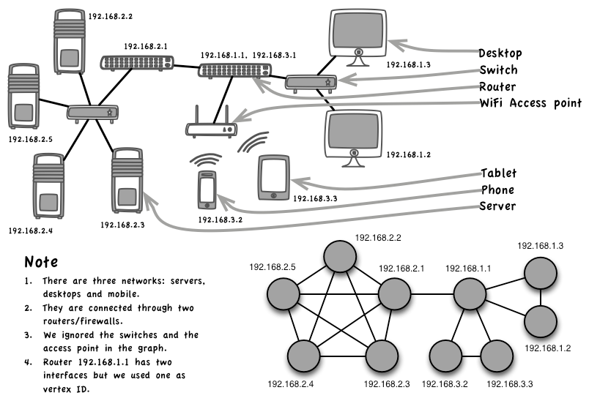
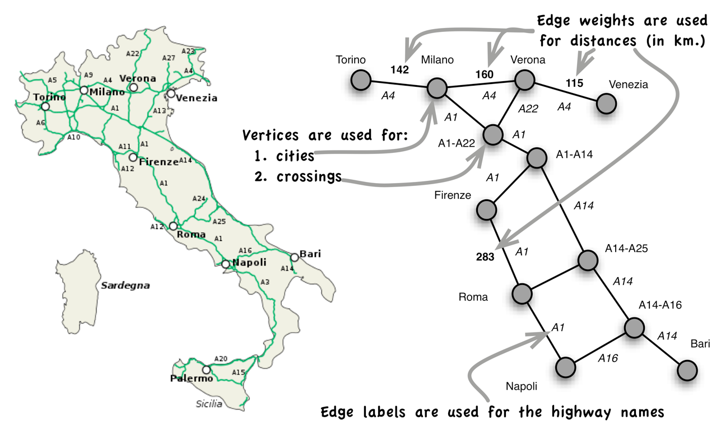
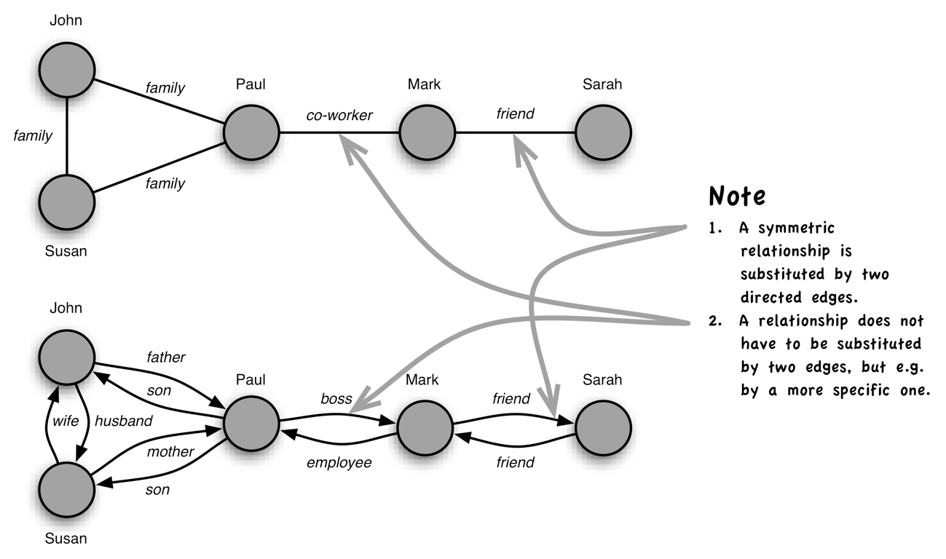
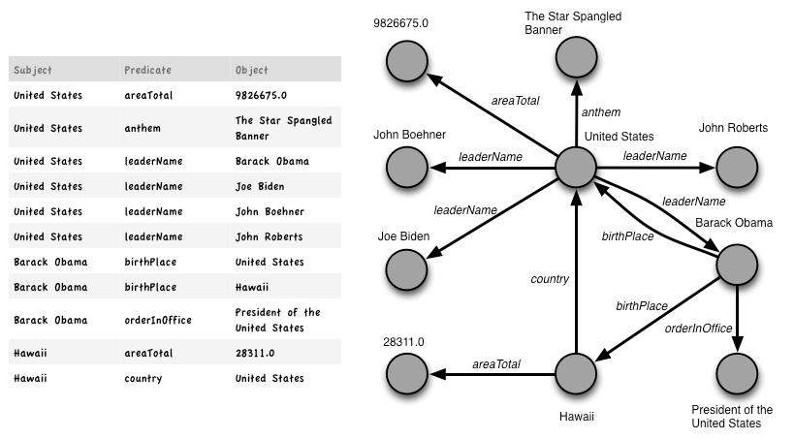
Graphs
Computing networks
Graphs are everywhere
Social networks
Semantic networks
Maps
Slides from http://www.slideshare.net/ClaudioMartella/giraph-at-hadoop-summit-2014

Slide 48
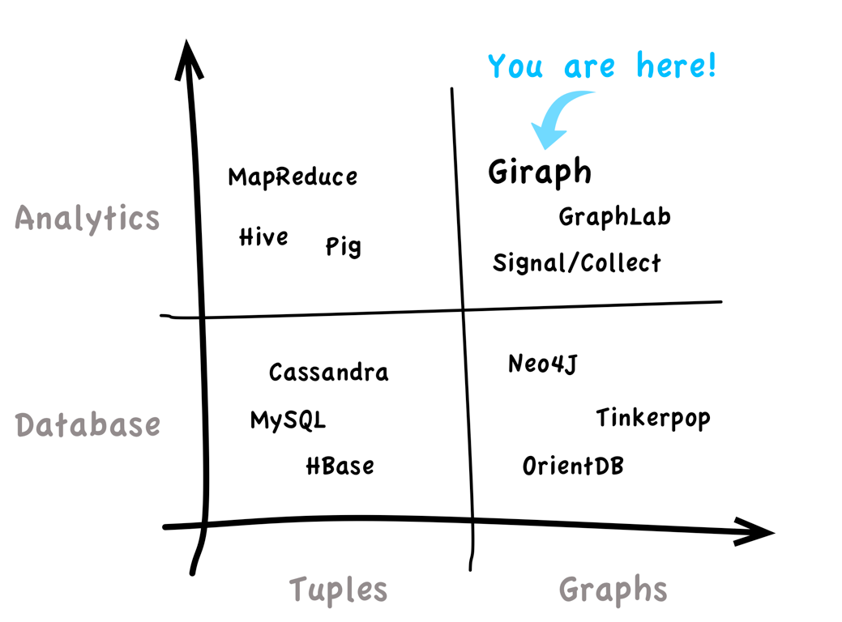
Giraph

Slide 49
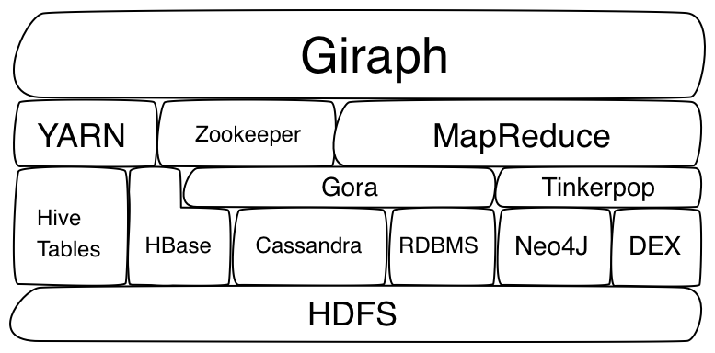
Giraph
Inspired by Google Pregel (2010) [1]
Initially developed by Yahoo!
Vertex-centric architecture inspired by Hadoop

Slide 50
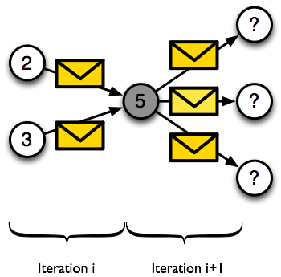
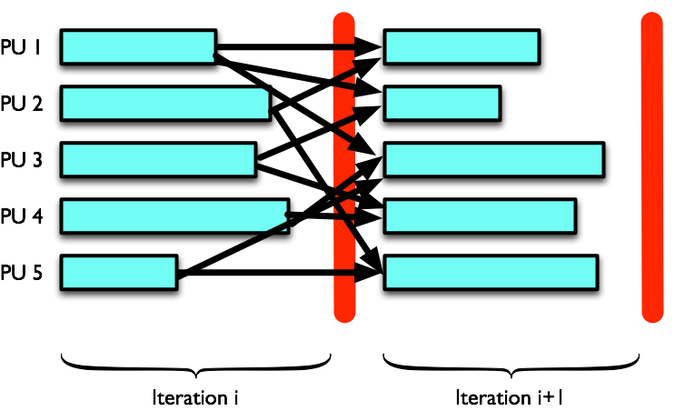
Giraph
Many types of computation on graphs can be expressed in sequential blocks
BSP model

Slide 51
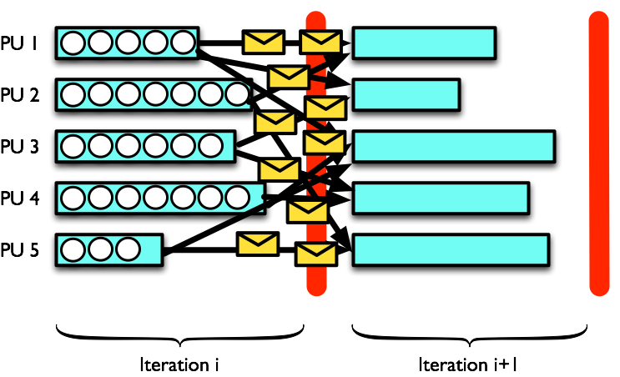
Giraph

Slide 52
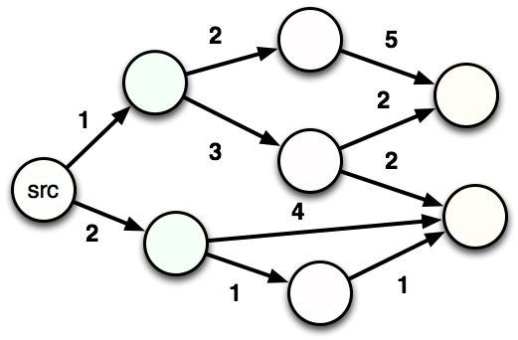
Shortest Paths
52

Slide 53
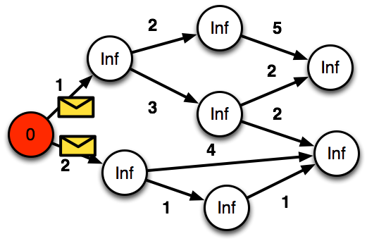
Shortest Paths
53

Slide 54
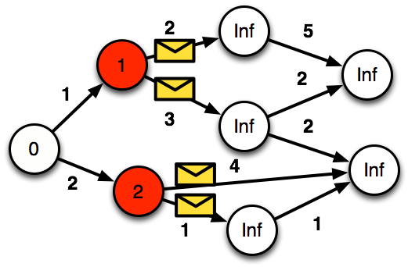
Shortest Paths
54

Slide 55
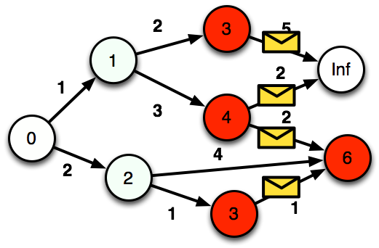
Shortest Paths
55

Slide 56
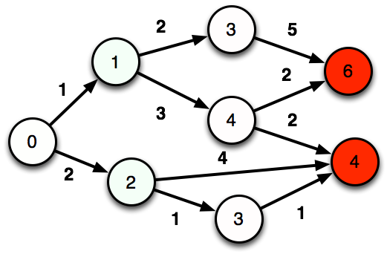
Shortest Paths
56

Slide 57
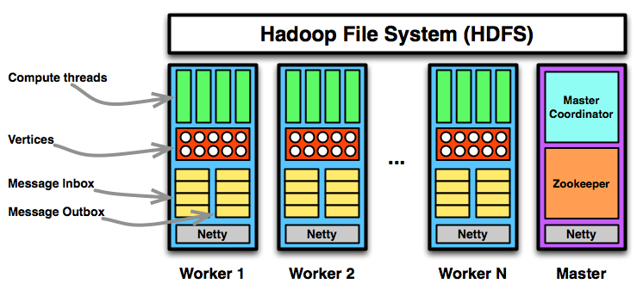
Giraph Architecture
57

Slide 58
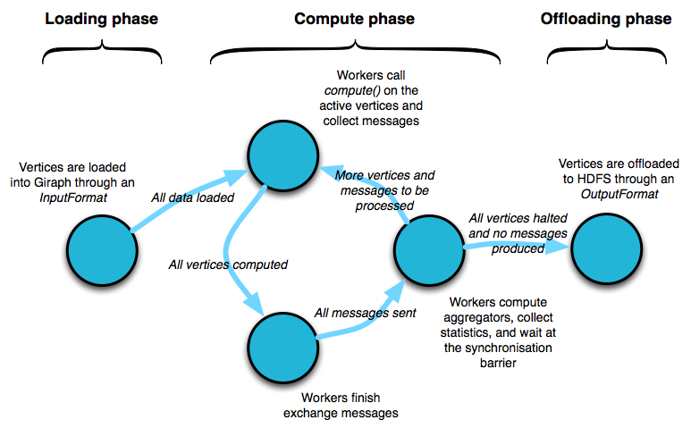
Giraph

Slide 59
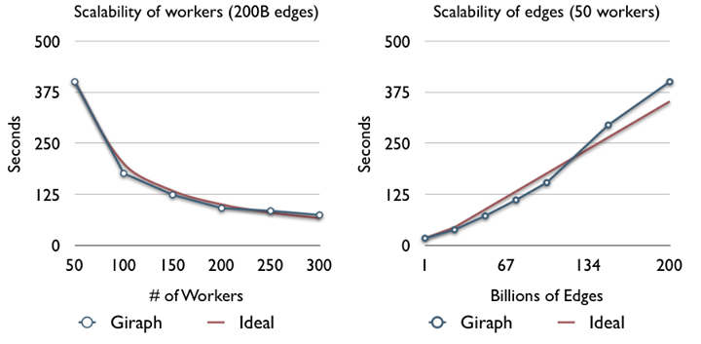
Giraph scales
ref: https://www.facebook.com/notes/facebook-engineering/scaling-apache-giraph-to-a-trillion-edges/10151617006153920
59

